Slide 1
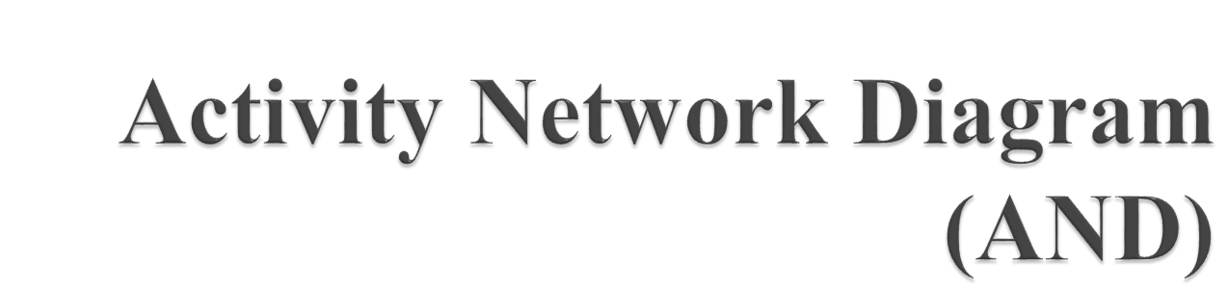

Slide 2
A quality management tool that charts the flow of activity between separate tasks.
An activity network shows the different activities making up a project, their estimated durations, and their interdependencies.
Notes:
Use Case Relationship
Association relationship
May exist between actor and a use case
Often referred to as a communicate association
Navigable in both directions (actor to use case and use case to actor)
Some use just a line
Others use a double-headed arrowhead
Navigable in only one direction (actor to use case OR use case to actor)
Use a arrowhead where arrowhead denotes the direction of communication
Navigation direction of an association represents who is initiating the communication
Multiplicity
Not consistency shown on all use-case diagrams (Some do; some don’t)

Slide 3
Two equivalent representations for activity networks are possible and are in use:
Activity on Node (AoN): In this representation, each activity is represented by a rectangular box and the duration of the activity is shown alongside each task in the node.
Activity on Edge (AoE): In this representation, tasks are associated with the edges. The edges are also annotated with the task duration. The nodes is the graph represent project milestones.
Notes:
Use Case Relationship
Association relationship
May exist between actor and a use case
Often referred to as a communicate association
Navigable in both directions (actor to use case and use case to actor)
Some use just a line
Others use a double-headed arrowhead
Navigable in only one direction (actor to use case OR use case to actor)
Use a arrowhead where arrowhead denotes the direction of communication
Navigation direction of an association represents who is initiating the communication
Multiplicity
Not consistency shown on all use-case diagrams (Some do; some don’t)

Slide 4
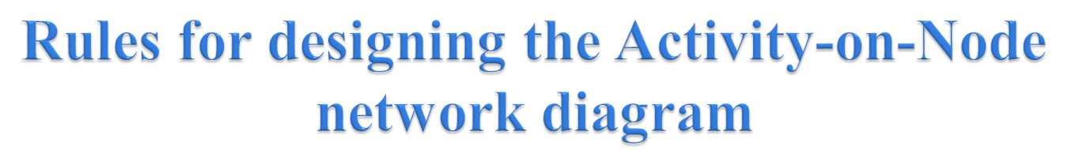
A project network should have only one start node
A project network should have only one end node
A node has a duration
Links normally have no duration
“Precedents” are the immediate preceding activities
Time moves from left to right in the project network
A network should not contain loops
A network should not contain dangles
Notes:
Use Case Relationship
Association relationship
May exist between actor and a use case
Often referred to as a communicate association
Navigable in both directions (actor to use case and use case to actor)
Some use just a line
Others use a double-headed arrowhead
Navigable in only one direction (actor to use case OR use case to actor)
Use a arrowhead where arrowhead denotes the direction of communication
Navigation direction of an association represents who is initiating the communication
Multiplicity
Not consistency shown on all use-case diagrams (Some do; some don’t)

Slide 5

Critical Path Method (CPM) is a method used in project planning, generally for project scheduling for the on-time completion of the project.
It actually helps in the determination of the earliest time by which the whole project can be completed.
There are two main concepts in this method namely critical task and critical path.
Notes:
Use Case Relationship
Association relationship
May exist between actor and a use case
Often referred to as a communicate association
Navigable in both directions (actor to use case and use case to actor)
Some use just a line
Others use a double-headed arrowhead
Navigable in only one direction (actor to use case OR use case to actor)
Use a arrowhead where arrowhead denotes the direction of communication
Navigation direction of an association represents who is initiating the communication
Multiplicity
Not consistency shown on all use-case diagrams (Some do; some don’t)

Slide 6
Critical task is the task/activity which can’t be delayed otherwise the completion of the whole project will be delayed.
It must be completed on-time before starting the other dependent tasks.
Notes:
Use Case Relationship
Association relationship
May exist between actor and a use case
Often referred to as a communicate association
Navigable in both directions (actor to use case and use case to actor)
Some use just a line
Others use a double-headed arrowhead
Navigable in only one direction (actor to use case OR use case to actor)
Use a arrowhead where arrowhead denotes the direction of communication
Navigation direction of an association represents who is initiating the communication
Multiplicity
Not consistency shown on all use-case diagrams (Some do; some don’t)

Slide 7
Critical path is a sequence of critical tasks/activities and is the largest path in the project network.
It gives us the minimum time which is required to complete the whole project. The activities in the critical path are known as critical activities and if these activities are delayed then the completion of the whole project is also delayed.
Notes:
Use Case Relationship
Association relationship
May exist between actor and a use case
Often referred to as a communicate association
Navigable in both directions (actor to use case and use case to actor)
Some use just a line
Others use a double-headed arrowhead
Navigable in only one direction (actor to use case OR use case to actor)
Use a arrowhead where arrowhead denotes the direction of communication
Navigation direction of an association represents who is initiating the communication
Multiplicity
Not consistency shown on all use-case diagrams (Some do; some don’t)

Slide 8

Identifying the activities
2. Construct the project network
3. Perform time estimation using forward and backward pass
4. Identify the critical path
Notes:
Use Case Relationship
Association relationship
May exist between actor and a use case
Often referred to as a communicate association
Navigable in both directions (actor to use case and use case to actor)
Some use just a line
Others use a double-headed arrowhead
Navigable in only one direction (actor to use case OR use case to actor)
Use a arrowhead where arrowhead denotes the direction of communication
Navigation direction of an association represents who is initiating the communication
Multiplicity
Not consistency shown on all use-case diagrams (Some do; some don’t)

Slide 9

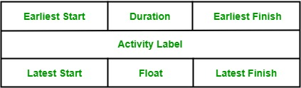
Notes:
Use Case Relationship
Association relationship
May exist between actor and a use case
Often referred to as a communicate association
Navigable in both directions (actor to use case and use case to actor)
Some use just a line
Others use a double-headed arrowhead
Navigable in only one direction (actor to use case OR use case to actor)
Use a arrowhead where arrowhead denotes the direction of communication
Navigation direction of an association represents who is initiating the communication
Multiplicity
Not consistency shown on all use-case diagrams (Some do; some don’t)

Slide 10
Activity label is the name of the activity represented by that node.
Earliest Start is the date or time at which the activity can be started at the earliest.
Earliest Finish is the date or time at which the activity can completed at the earliest.
Notes:
Use Case Relationship
Association relationship
May exist between actor and a use case
Often referred to as a communicate association
Navigable in both directions (actor to use case and use case to actor)
Some use just a line
Others use a double-headed arrowhead
Navigable in only one direction (actor to use case OR use case to actor)
Use a arrowhead where arrowhead denotes the direction of communication
Navigation direction of an association represents who is initiating the communication
Multiplicity
Not consistency shown on all use-case diagrams (Some do; some don’t)

Slide 11
Latest Start is the date or time at which the activity can be started at the latest.
Latest Finish is the date or time at which the activity can be finished at the latest.
Float is equal to the difference between earliest start and latest start or earliest finish and latest finish.
Notes:
Use Case Relationship
Association relationship
May exist between actor and a use case
Often referred to as a communicate association
Navigable in both directions (actor to use case and use case to actor)
Some use just a line
Others use a double-headed arrowhead
Navigable in only one direction (actor to use case OR use case to actor)
Use a arrowhead where arrowhead denotes the direction of communication
Navigation direction of an association represents who is initiating the communication
Multiplicity
Not consistency shown on all use-case diagrams (Some do; some don’t)

Slide 12

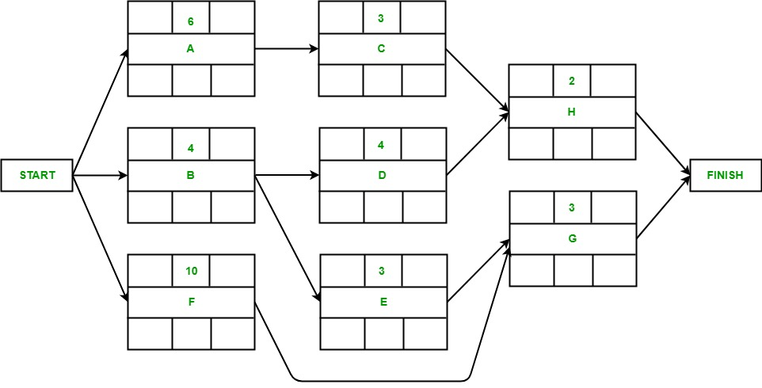
Notes:
Use Case Relationship
Association relationship
May exist between actor and a use case
Often referred to as a communicate association
Navigable in both directions (actor to use case and use case to actor)
Some use just a line
Others use a double-headed arrowhead
Navigable in only one direction (actor to use case OR use case to actor)
Use a arrowhead where arrowhead denotes the direction of communication
Navigation direction of an association represents who is initiating the communication
Multiplicity
Not consistency shown on all use-case diagrams (Some do; some don’t)

Slide 13
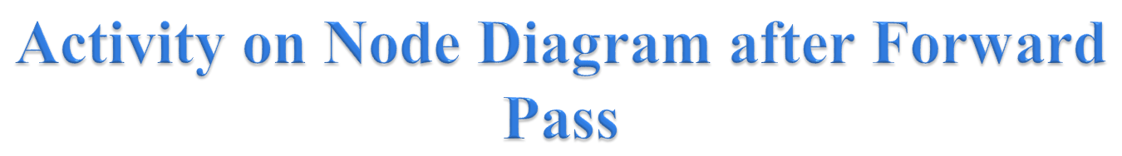
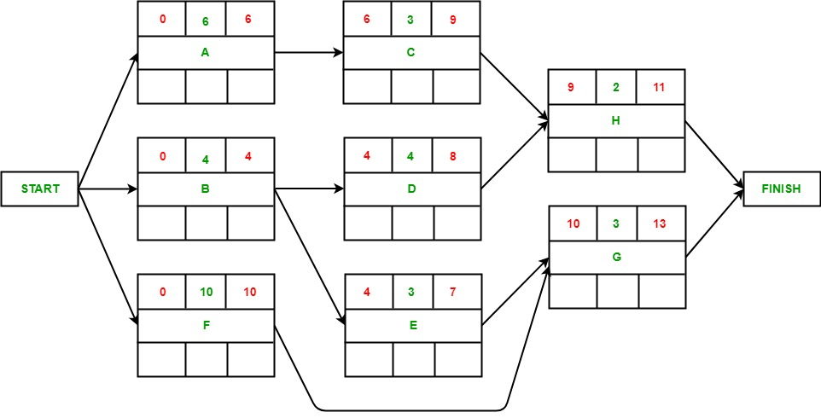
Notes:
Use Case Relationship
Association relationship
May exist between actor and a use case
Often referred to as a communicate association
Navigable in both directions (actor to use case and use case to actor)
Some use just a line
Others use a double-headed arrowhead
Navigable in only one direction (actor to use case OR use case to actor)
Use a arrowhead where arrowhead denotes the direction of communication
Navigation direction of an association represents who is initiating the communication
Multiplicity
Not consistency shown on all use-case diagrams (Some do; some don’t)

Slide 14
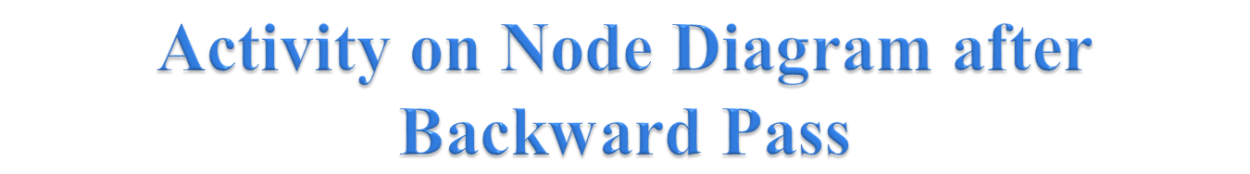
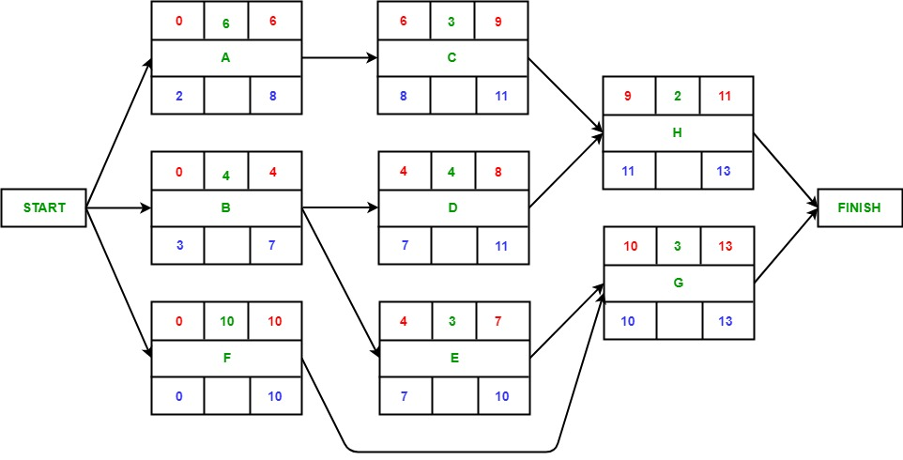
Notes:
Use Case Relationship
Association relationship
May exist between actor and a use case
Often referred to as a communicate association
Navigable in both directions (actor to use case and use case to actor)
Some use just a line
Others use a double-headed arrowhead
Navigable in only one direction (actor to use case OR use case to actor)
Use a arrowhead where arrowhead denotes the direction of communication
Navigation direction of an association represents who is initiating the communication
Multiplicity
Not consistency shown on all use-case diagrams (Some do; some don’t)

Slide 15

Critical path is the path which gives us or helps us to estimate the earliest time in which the whole project can be completed.
Any delay to an activity on this critical path will lead to a delay in the completion of the whole project. In order to identify the critical path, we need to calculate the activity float for each activity.
Notes:
Use Case Relationship
Association relationship
May exist between actor and a use case
Often referred to as a communicate association
Navigable in both directions (actor to use case and use case to actor)
Some use just a line
Others use a double-headed arrowhead
Navigable in only one direction (actor to use case OR use case to actor)
Use a arrowhead where arrowhead denotes the direction of communication
Navigation direction of an association represents who is initiating the communication
Multiplicity
Not consistency shown on all use-case diagrams (Some do; some don’t)

Slide 16
If the float of an activity is zero, then the activity is a critical activity and must be added to the critical path of the project network.
In this example, activity F and G have zero float and hence, are critical activities.
Notes:
Use Case Relationship
Association relationship
May exist between actor and a use case
Often referred to as a communicate association
Navigable in both directions (actor to use case and use case to actor)
Some use just a line
Others use a double-headed arrowhead
Navigable in only one direction (actor to use case OR use case to actor)
Use a arrowhead where arrowhead denotes the direction of communication
Navigation direction of an association represents who is initiating the communication
Multiplicity
Not consistency shown on all use-case diagrams (Some do; some don’t)

Slide 17

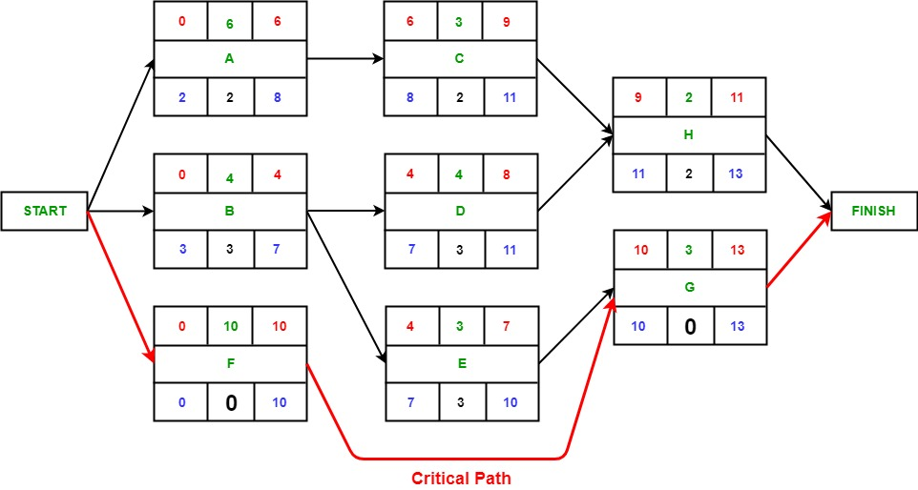
Notes:
Use Case Relationship
Association relationship
May exist between actor and a use case
Often referred to as a communicate association
Navigable in both directions (actor to use case and use case to actor)
Some use just a line
Others use a double-headed arrowhead
Navigable in only one direction (actor to use case OR use case to actor)
Use a arrowhead where arrowhead denotes the direction of communication
Navigation direction of an association represents who is initiating the communication
Multiplicity
Not consistency shown on all use-case diagrams (Some do; some don’t)

Slide 18

The activity durations computed using an activity network are only estimated durations.
Since, the actual durations might vary from the estimated durations, the utility of the activity network diagrams are limited.
The CPM can be used to determine the duration of the project, but does not provide any indication of the probability of meeting that schedule
Notes:
Use Case Relationship
Association relationship
May exist between actor and a use case
Often referred to as a communicate association
Navigable in both directions (actor to use case and use case to actor)
Some use just a line
Others use a double-headed arrowhead
Navigable in only one direction (actor to use case OR use case to actor)
Use a arrowhead where arrowhead denotes the direction of communication
Navigation direction of an association represents who is initiating the communication
Multiplicity
Not consistency shown on all use-case diagrams (Some do; some don’t)

Slide 19
Project Evaluation and Review Technique (PERT) charts are a more sophisticated form of activity chart.
PERT allows for some randomness in task completion times, and therefore provides the capability to determine the probability for achieving project milestones.
Notes:
Use Case Relationship
Association relationship
May exist between actor and a use case
Often referred to as a communicate association
Navigable in both directions (actor to use case and use case to actor)
Some use just a line
Others use a double-headed arrowhead
Navigable in only one direction (actor to use case OR use case to actor)
Use a arrowhead where arrowhead denotes the direction of communication
Navigation direction of an association represents who is initiating the communication
Multiplicity
Not consistency shown on all use-case diagrams (Some do; some don’t)

Slide 20
Each task is annotated with three estimates:
Optimistic (O): The best possible case task completion time.
Most Likely Estimate (M): Most likely task completion time.
Worst Case (W): The worst possible case task completion time.
Notes:
Use Case Relationship
Association relationship
May exist between actor and a use case
Often referred to as a communicate association
Navigable in both directions (actor to use case and use case to actor)
Some use just a line
Others use a double-headed arrowhead
Navigable in only one direction (actor to use case OR use case to actor)
Use a arrowhead where arrowhead denotes the direction of communication
Navigation direction of an association represents who is initiating the communication
Multiplicity
Not consistency shown on all use-case diagrams (Some do; some don’t)

